Slide 1
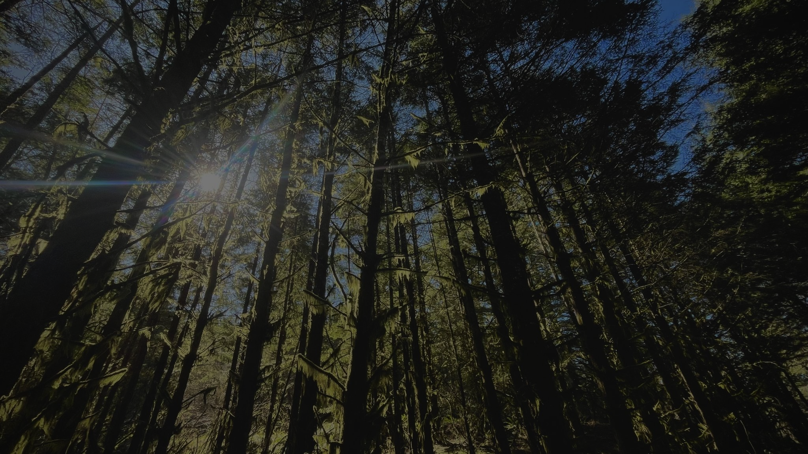
Old Trees and New Climate: How do Douglas-fir and Western Hemlock Respond to Heat Waves?
Gabby John
Pacific Northwest Water Research Symposium
May 20, 2024

Slide 2
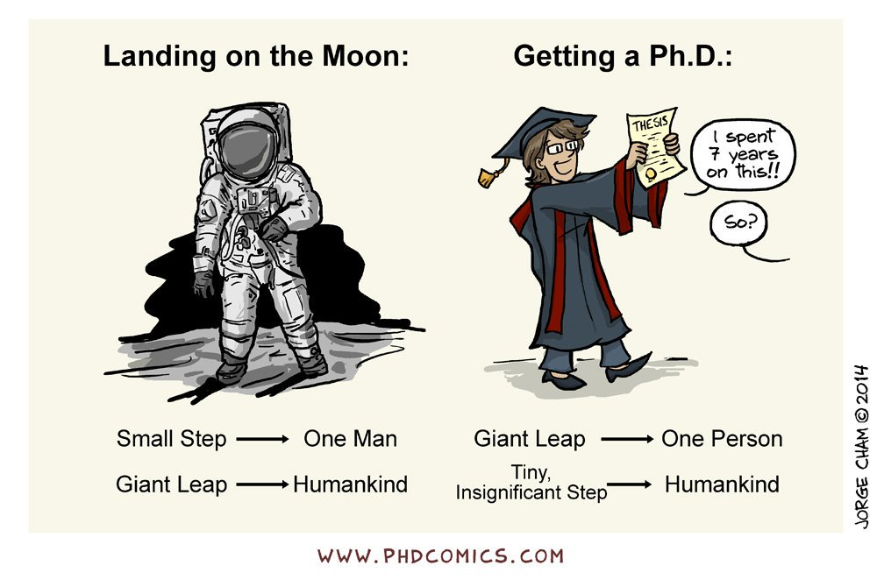
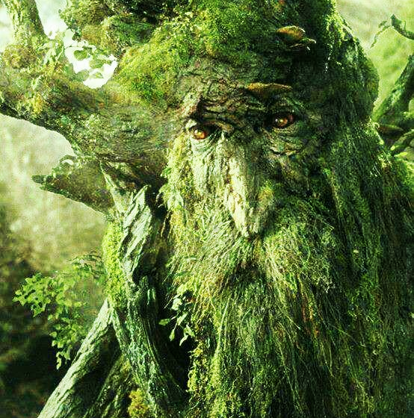
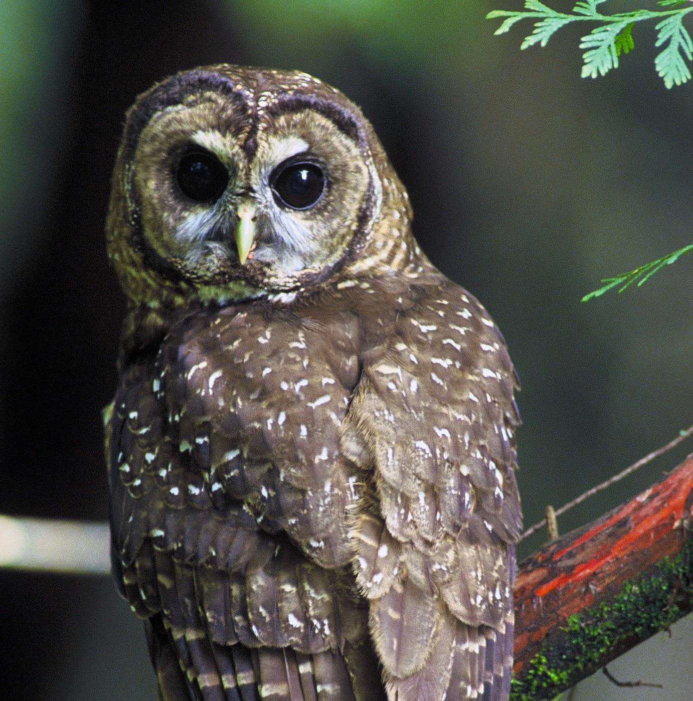
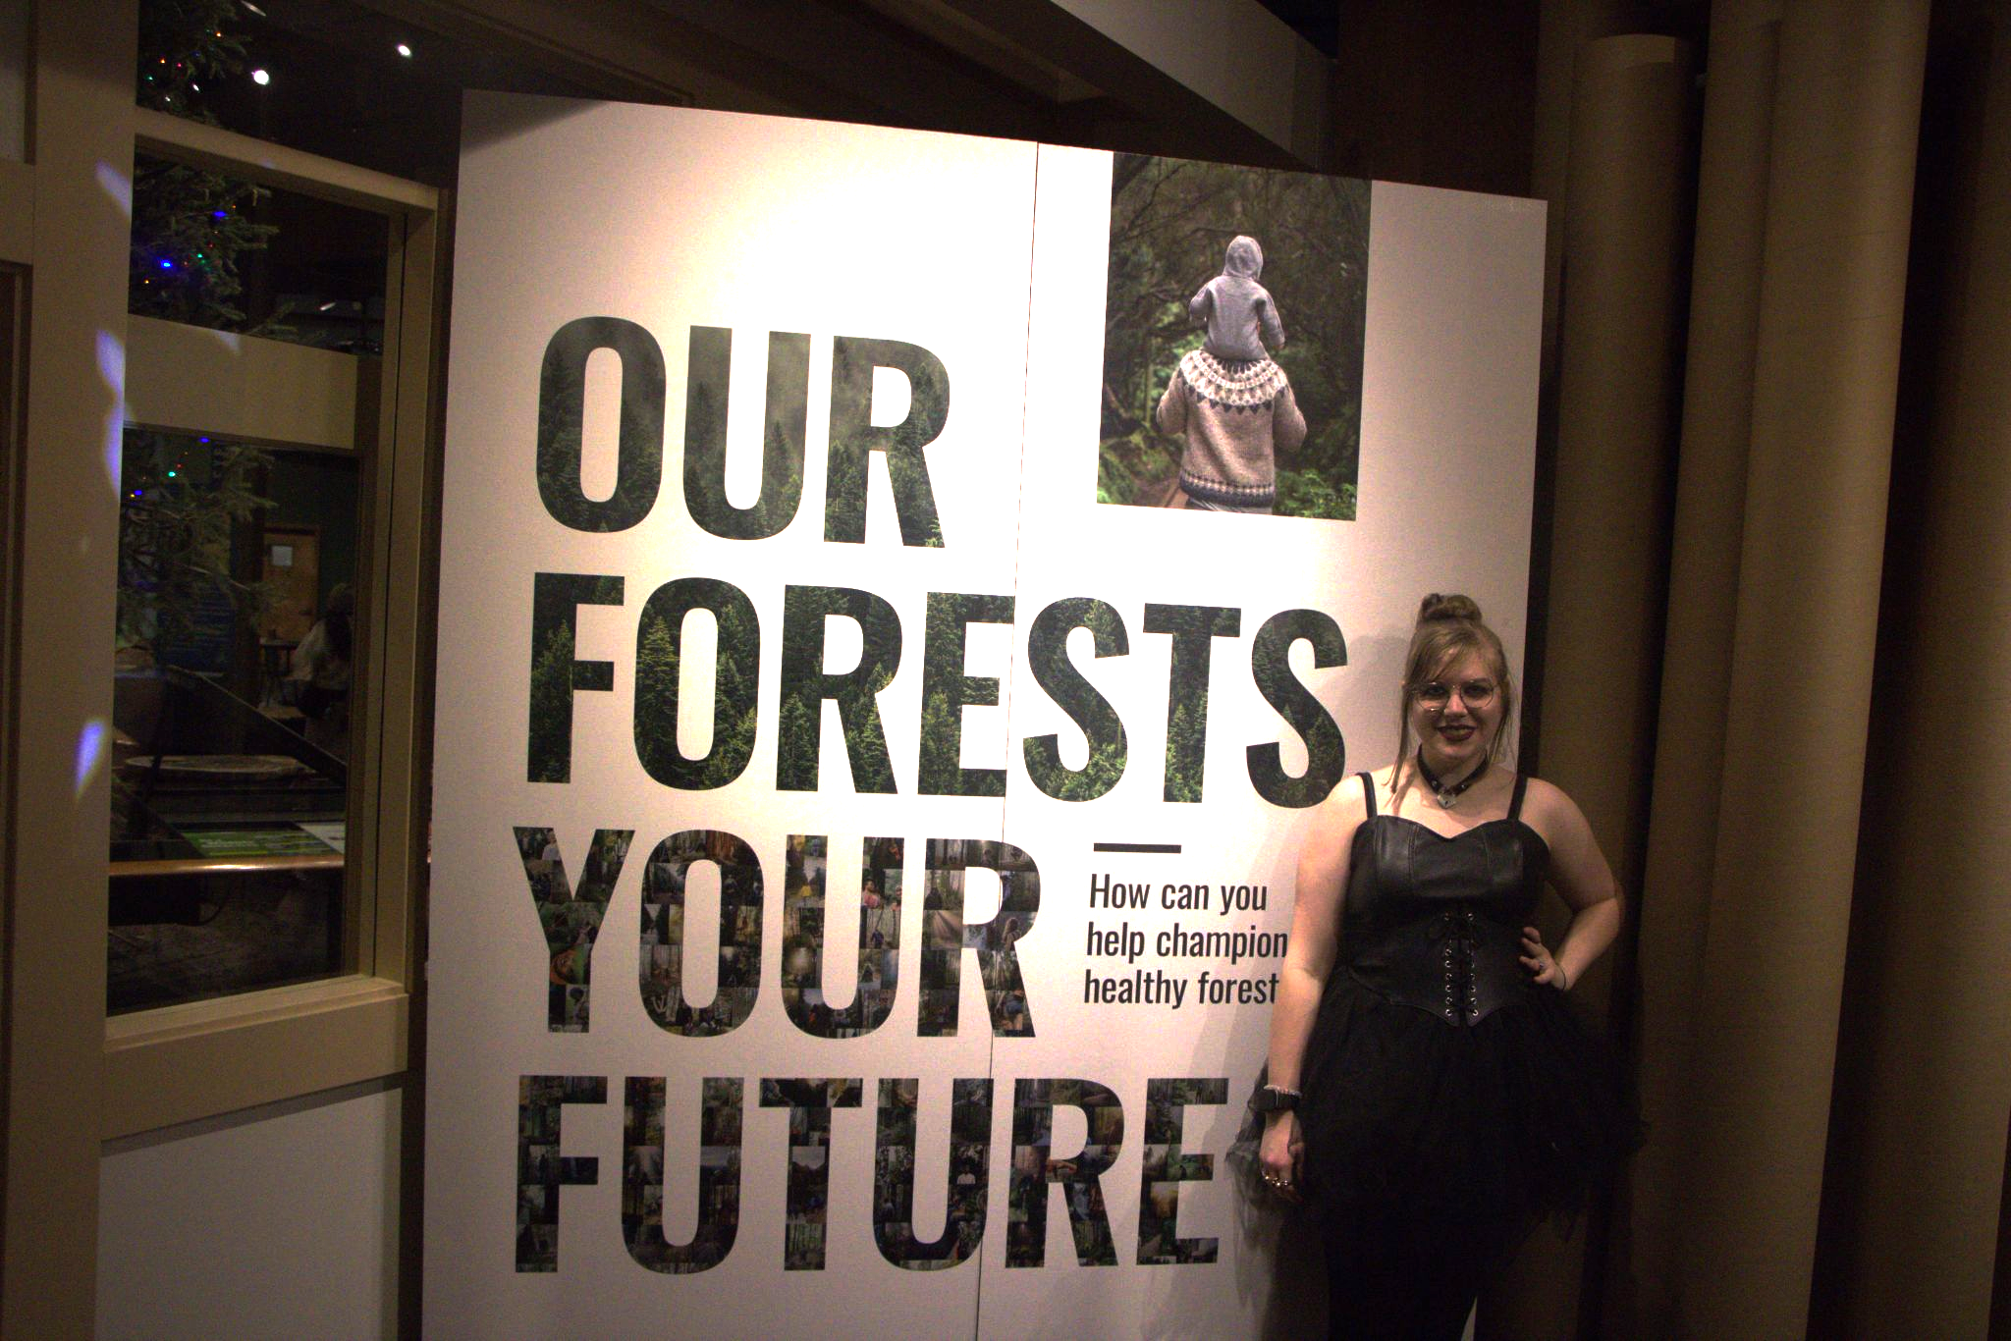
Why does this topic matter?
M.S. in progress
Old trees rock
Old forests rock
They need help
This is my thesis project for a M.S. in Forest Ecosystems and Society in the OSU CoF
“Old-growth” trees are at least 200 years old. They work differently than younger trees do
Old-growth forests store more carbon, biodiversity, and habitat than younger forests, too
Changes in climate and land use mean old-growth forests need extra attention, which is hard

Slide 3
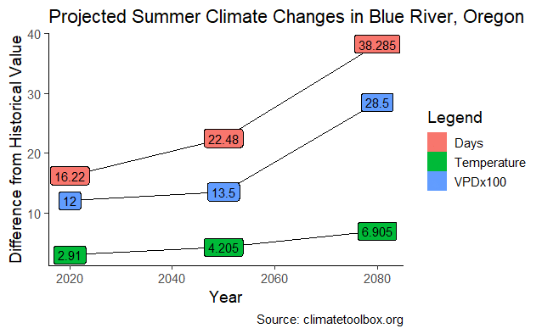
Scientists use models instead of crystal balls
Source: climatetoolbox.org
More VPD (vapor pressure deficit)... more drought stress… less photosynthesis… less net carbon uptake…more atmospheric carbon?
Stress brings more stress
Fear of tipping point?

Slide 4
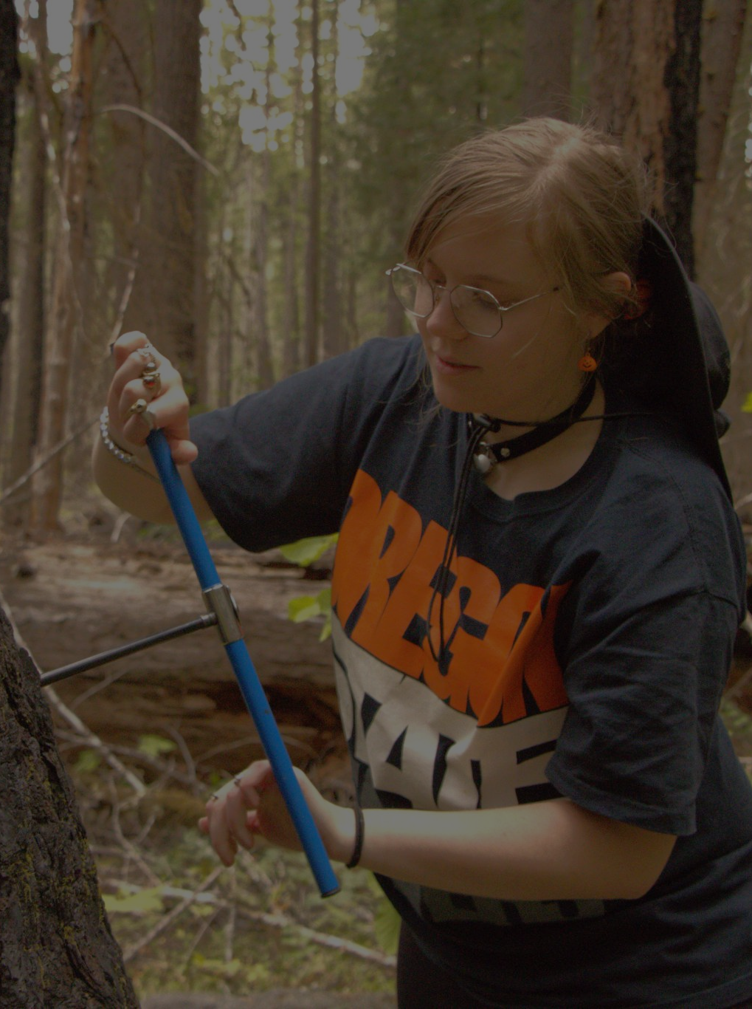
What to do?
What physiological changes occur among old-growth Douglas-fir and western hemlock in western Oregon before, during, and after a heat wave?
Collect short and long-term data to pair tree growth and weather at the HJ Andrews Experimental Forest
Dendrometer data + tree cores
Analyze data and draw conclusions
Coming soon…summer 2025!

Slide 5
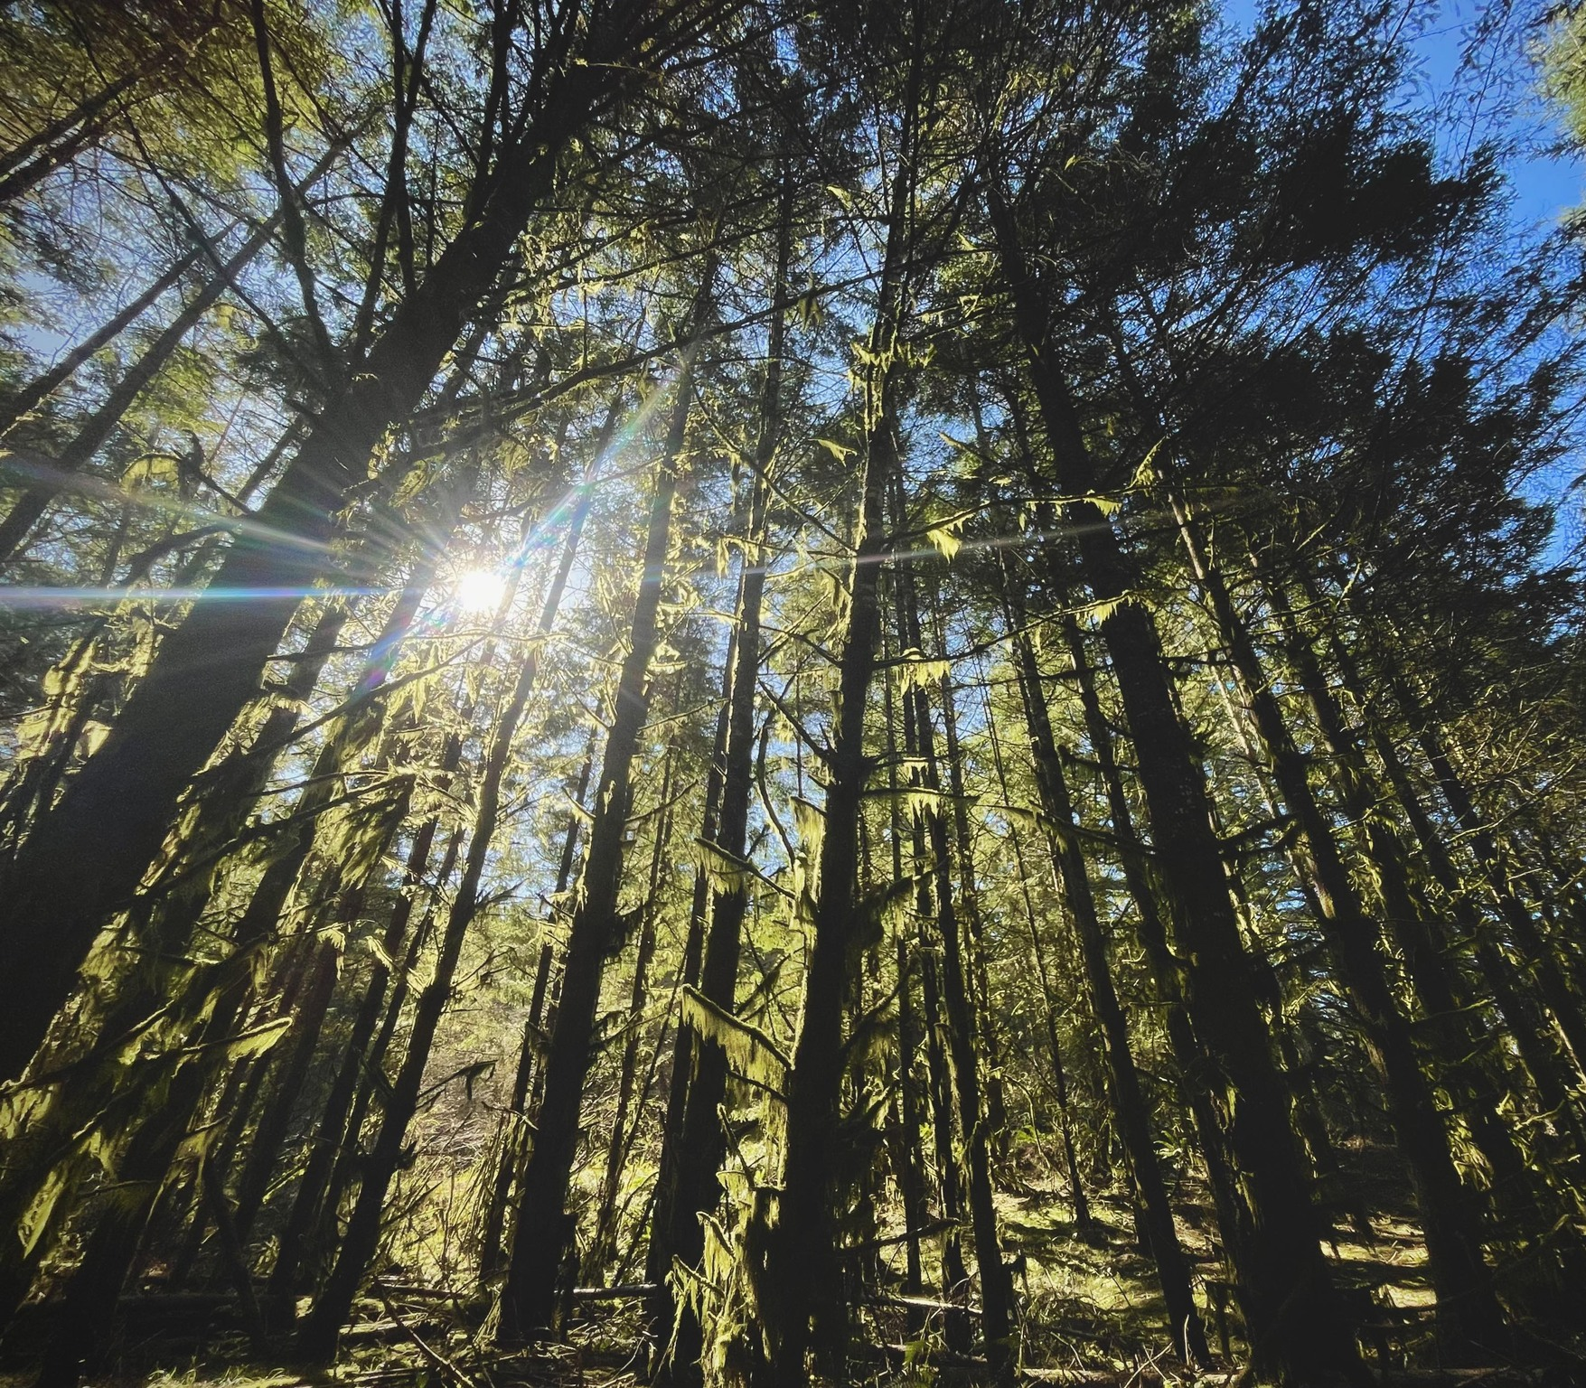
Thank
You!

